Slide 1
Intern Weekly Report Summary
MSRA HEX Intern
Jack Zeng
June - September 2023

Slide 2
General goals (not all)
Enhance LLM’s ability on edge side, reduce cost on server side
Edge side: Laptop, smartphone, small business’ servers…
Decrease the difference between smaller LLM and larger LLM
Try to train a “personalized” edge-side LLM
Could answer private information questions

Slide 3
Week 1 & 2

Slide 4
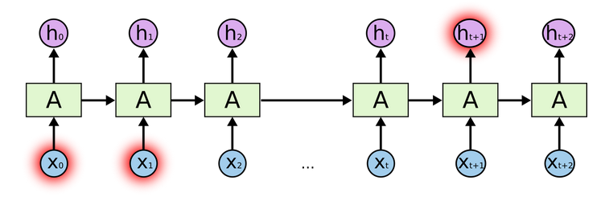
Transformer: Why not RNN?
RNN generates hidden states -> precludes parallelization
Long-term dependency problem
Potential solution: LSTM

Slide 5
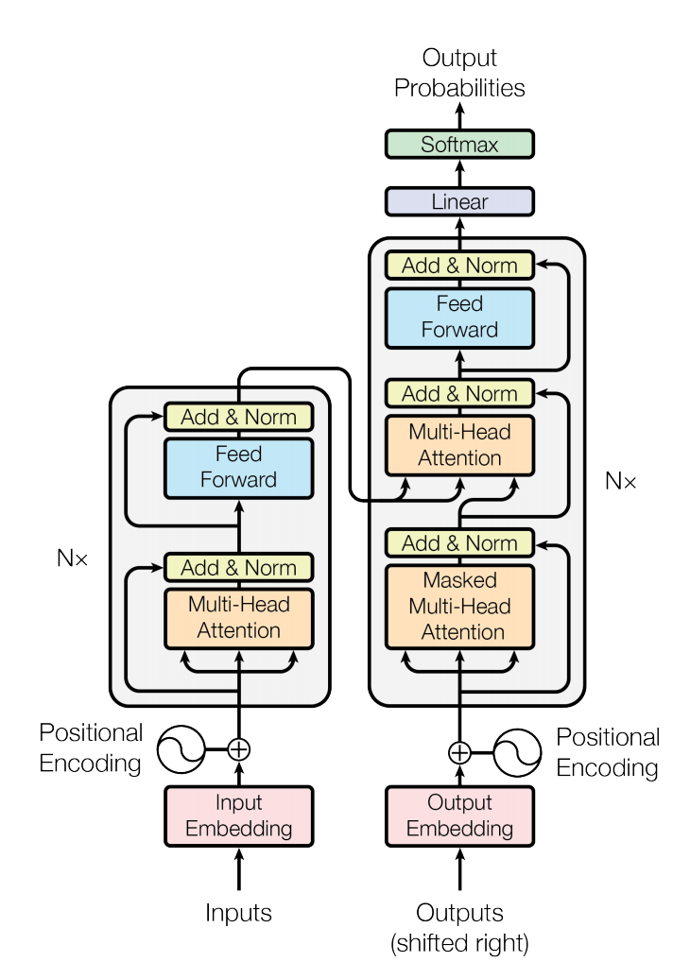
Transformer: Structure
Left part: encoder
Right part: decoder
It consists
Adding and Normalization Layer
Feed-Forward Layer
Multi-Head Attention Layer
Positional Encoding

Slide 6
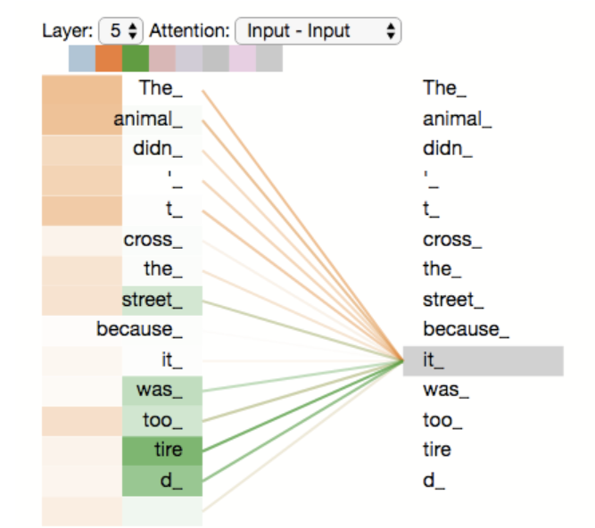


Transformer: Encoder and Decoder in Detail
Encoder:
Self-attention
Three matrix (vector) for each word (after embedding): Query, Key and Value
Query (text in the search bar)
Key (video title, description)
Value (best matched videos)
Each matrix is the product of embedding matrices and corresponding weights (similarity calculation)
$\sqrt{d_{k}}$: Make gradient values remain stable during training (distribution of softmax function is highly related to d)
Multi-head attention: compute multiple attentions from the input information in parallel
Purpose of self-attention:
Easier to capture long-distance dependency features in sentences

Slide 7
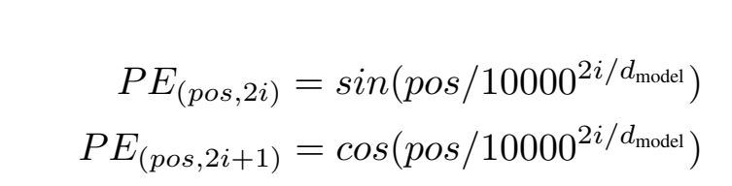
Transformer: Continue…
“Encoder-Decoder” Attention (masked attention)
Same calculation method as self-attention
Q -> last output from decoder
K and V -> outputs from encoder
Purpose: focus on appropriate place in the input
Position Encoding: Provide relative location info

Slide 8
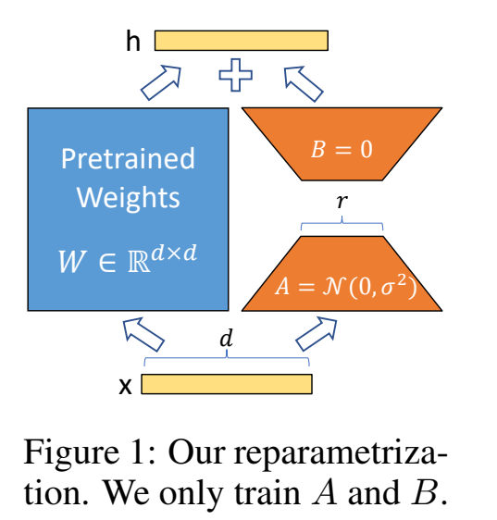
LoRA (Low-Rank Adaptation)
Low-rank transformation:
Approximate high-dimensional matrix using low dimensional representation
Purpose: Increase fine tuning efficiency
Low intrinsic dimension
Key idea:
Decompose weight update matrix into two smaller (A and B on the right)
Train matrix A and B only

Slide 9
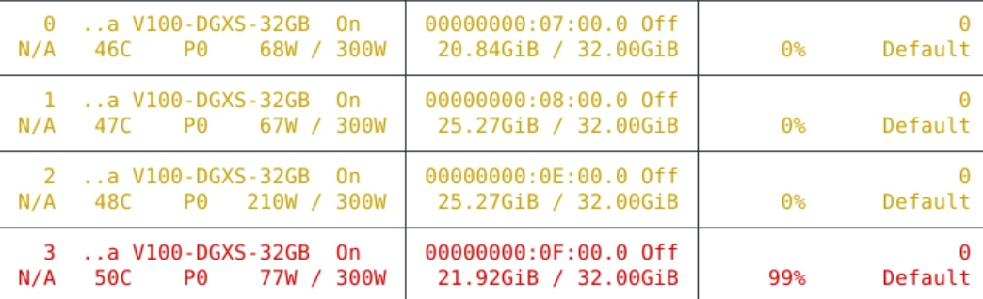
LoRA Applications and Issues (On week 2)
Using LoRA to fine-tune ChatGLM-6B
Issues:
GPU usage (solved by using Hugging Face’s Accelerate)
Prompting (not solved yet)

Slide 10
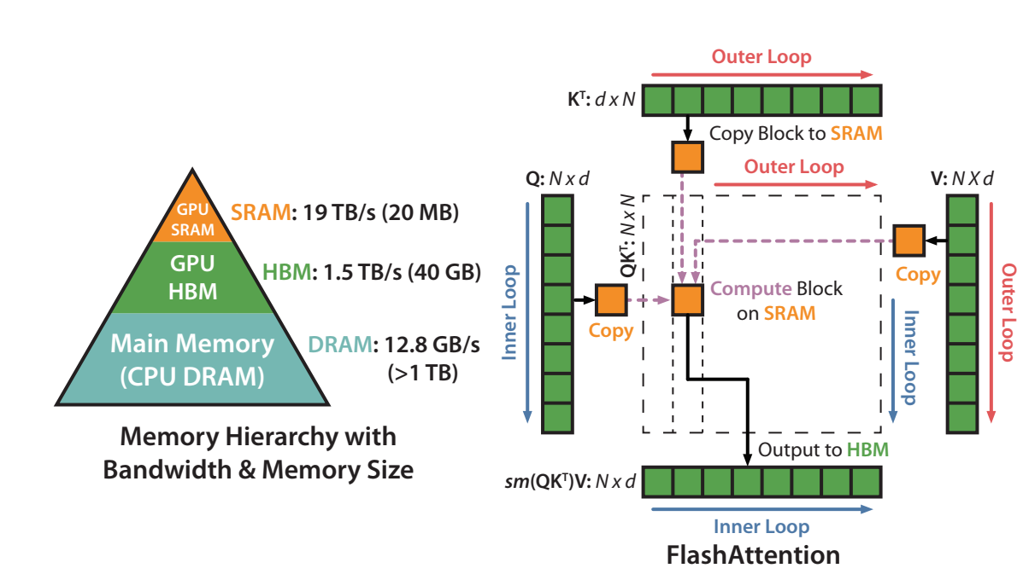
Flash Attention (Roughly)
Key idea: dividing operations between faster and slower levels of GPU memory
Compute-bound and memory-bound
For transformer, bottleneck -> attention matrix on the HBM and repeating read/write
Tilting: split the inputs Q, K, V into blocks and combine
Recompute: store softmax()

